Slide 1

Doctor’s Appointment
Team 10: Luna Zheng, Yoki Yang, Hiroshi Chakma, Haitian Yu

Slide 2

Data and Research Topic
Will A Patient Show Up to An Appointment?
Medical resources are scarce and the correct allocation of resources continues to be a problem. Understanding the factors that influence patients show up or not may provide insights to improve the efficiency and reduce cost.
110,527 data points
14 variables, 6 binary, 3 categorical
Prediction : Show VS. No Show

Slide 3
Data Cleaning
Create New Variables
Narrow Down Factors
Unrecognized Data
Inconsistency
Sorting Neighborhoods by Frequency
Creating Dummy Variables
Gap between AppointmentTime and ScheduleTime
Weekday & Hour
Separate the date column
Remove appointment time because they are all “0”
AppointmentTime Before ScheduleTime
Negative Ages
Spelling Mistakes

Slide 4
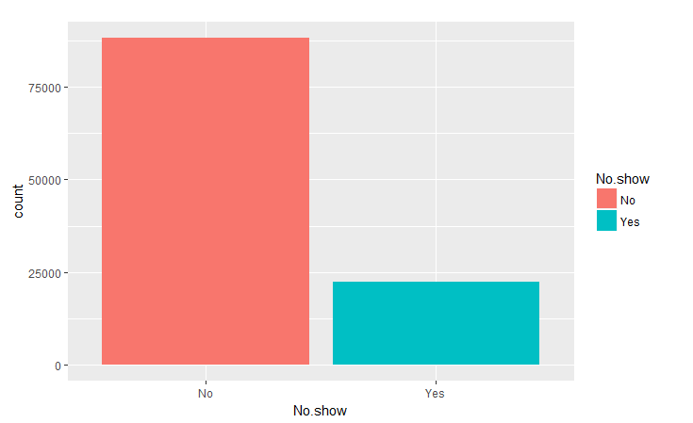
Data Visualization
Most people show up to appointments
20% ghost their doctors
Notes:
Once we cleaned up the data, we tried to get a better understanding of it so we didn’t jump into creating models blindly. The first thing we looked at was the ratio of no shows to shows. The good news is, most people do show up to their appointments, but we wanted to find out a little bit more.

Slide 5
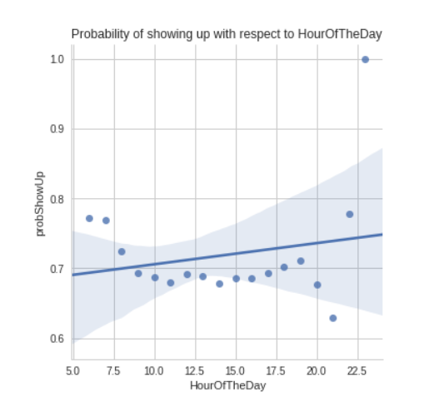
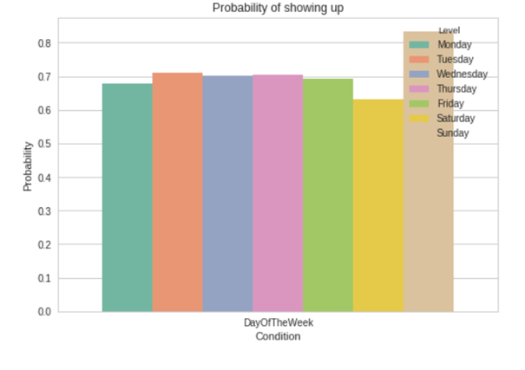
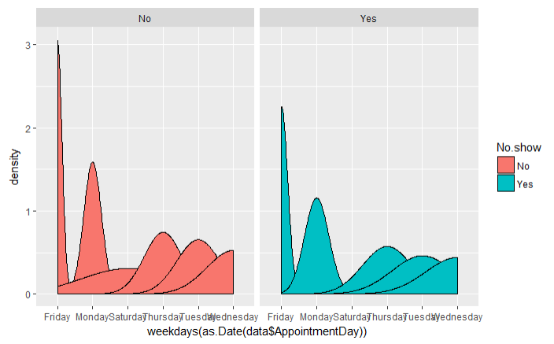
Data Visualization
Highest chance of no show at around 9pm.
People will always attend appointments around 11pm
Saturday has the highest chance of a no show & Sunday has the lowest.
Friday is the most popular time to see the doctor
Notes:
We decided to see if the time of the appointment played a factor in whether or not a person showed up to an appointment. We learned that Friday, although the most popular day for appointments, does not have the highest no show rate – that title belongs to Saturday. Interestingly enough, people are very committed to keeping their appointments on Sunday. When we consider the time of the day, we also learn a few things. Like the fact that 9pm has the highest no show rate… or the fact that at 11pm, everyone will show up to appointments without fail.

Slide 6
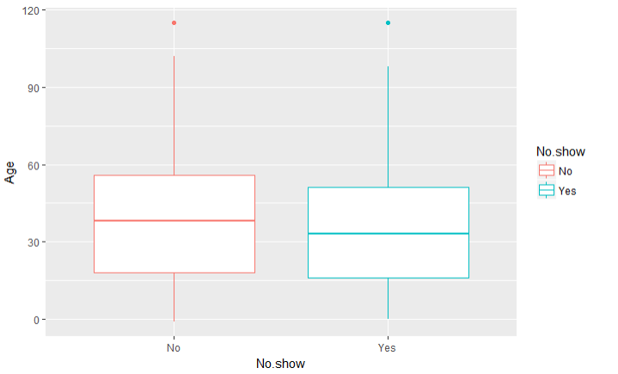
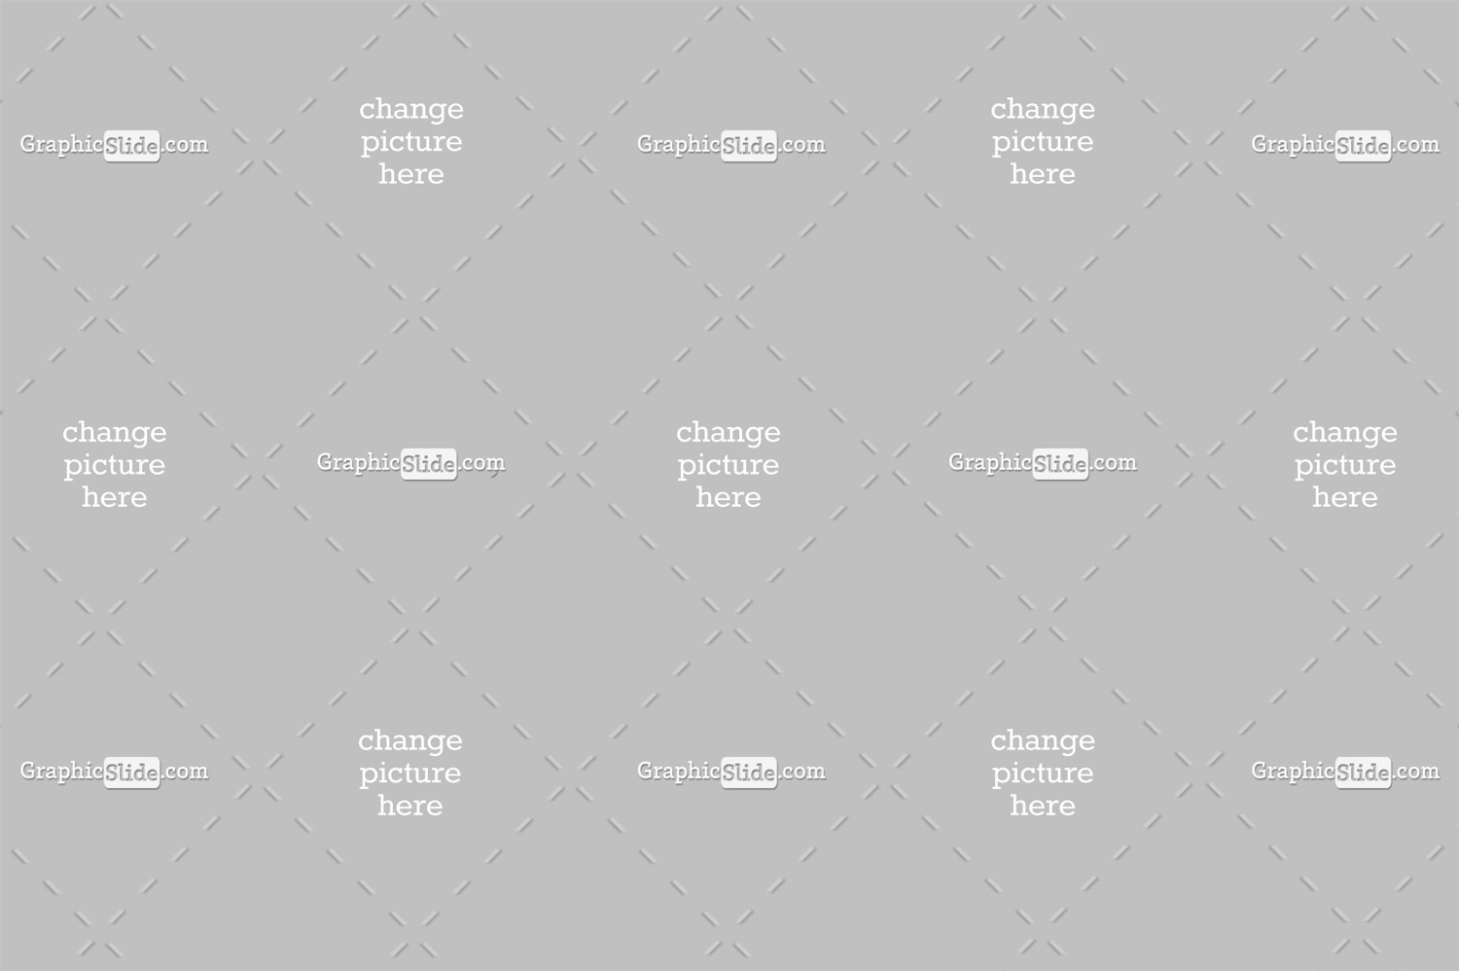
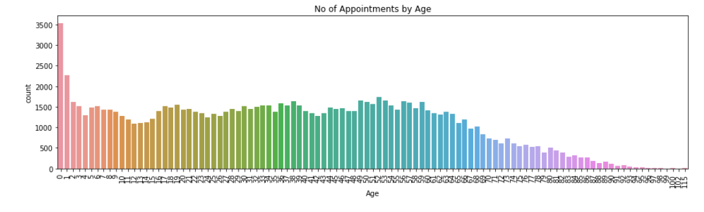
Data Visualization
Babies see the doctor A LOT.
Lacking data for individuals > 60
Project Sample
Younger people may be more likely to miss an appointment
Notes:
We then considered whether or not age played an influence on a person showing up to an appointment. From the graphs created, it could be inferred that younger people miss more appointments because the median and mean age for no shows is lower. A histogram of appointments by age shows that not only do babies see the doctor a lot, which makes sense, but also that we lack data for the senior population. Either that or they don’t see the doctor as much… which probably is not the case.

Slide 7
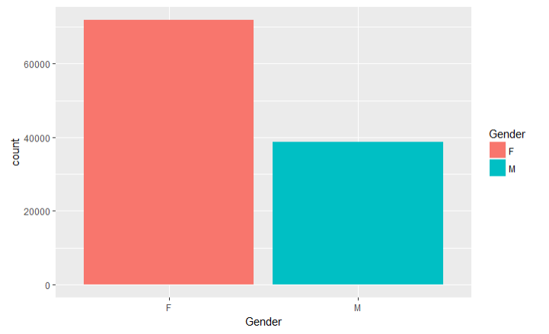
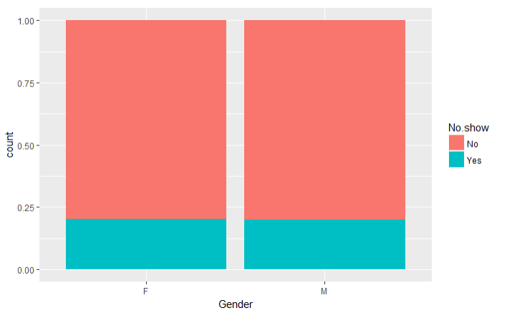
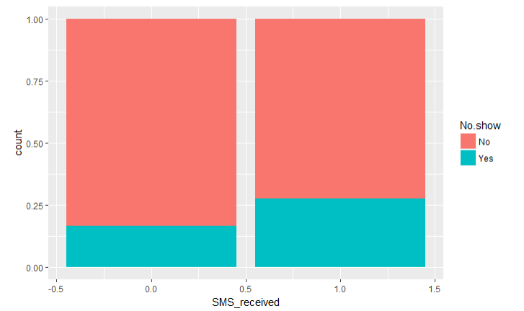
Data Visualization
876 Followers
Women see doctors more often than men but no difference in ability to show up
Patients LESS likely to show up if reminded by text/email beforehand
Notes:
Here are another few interesting finds from our data visualization. Women see doctors way more often than men… But there’s no discrepancy when it comes to their abilities to show up to an appointment. Also, patients are actually less likely to show up if they are reminded by message beforehand. We assume this is because the people who opt for an SMS reminder do so because they are more forgetful, but we do not know how the data was collected so it is difficult to tell. I will now pass it on to Yoki to talk about our data models.

Slide 8
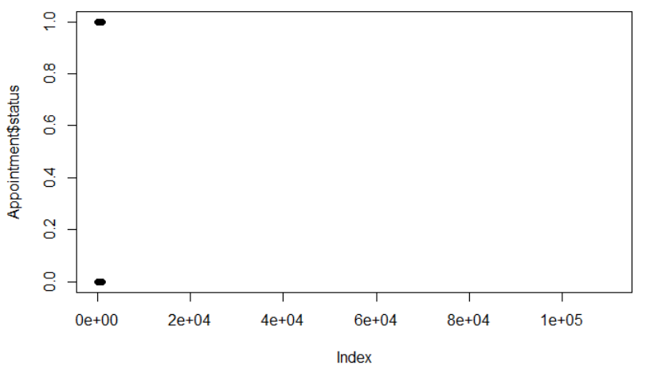
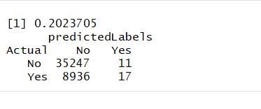
Linear Regression and KNN
Linear Regression
KNN
Assigned numeric values to dependent variables
Data visualization shows there are no linear relationships
The sampling rate for training set is 0.6 to accommodate for the size of the data.
Use K between 1 to 100
The best K is 82 with a misclassification rate of 20.23%

Slide 9
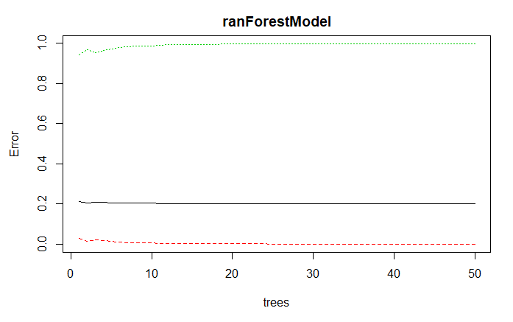
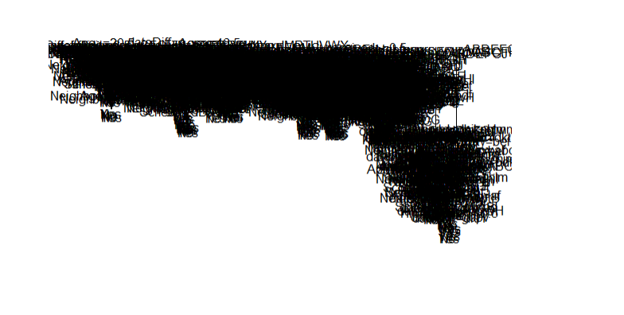
Decision Tree & Random Forest
R initially unable to create a decision tree of the data
Tree is drastically overfitted to the data
With K-Fold Validation, Misclassification = 21%
Random Forest Model showed very little decline in error as tree number increased
With K-Fold Validation, Misclassification = 20%

Slide 10
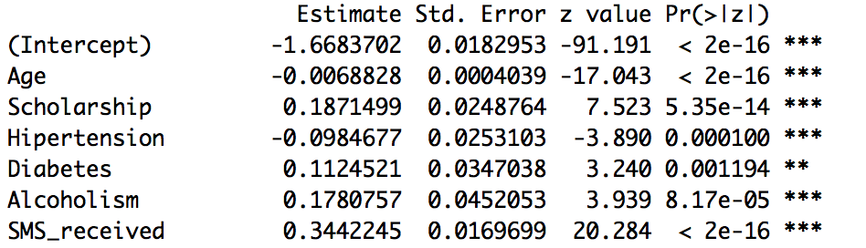
Logistic Regression
There are many variations
There are many variations
There are many variations
Misclassification Rate
There are many variations
Overall : 19.75%
False: “No” : 17.88%
False “Yes” : 1.73%
Notes:
False Yes– appointments predicted to be no show but showed

Slide 11
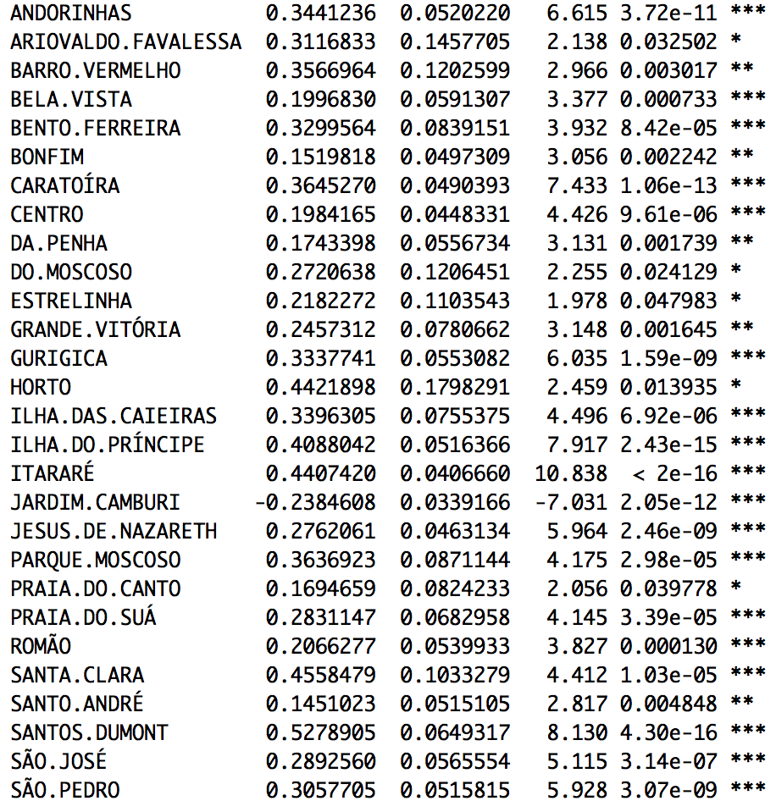
Logistic Regression
There are many variations
Dummy variables transformed from the feature “Neighborhood”
Speculation: These features are important because it is related to the distance
There are many variations
There are many variations
There are many variations
Notes:
False Yes– appointments predicted to be no show but showed

Slide 12
K-Means
Unsupervised Learning – doesn’t fit with our dataset

Slide 13
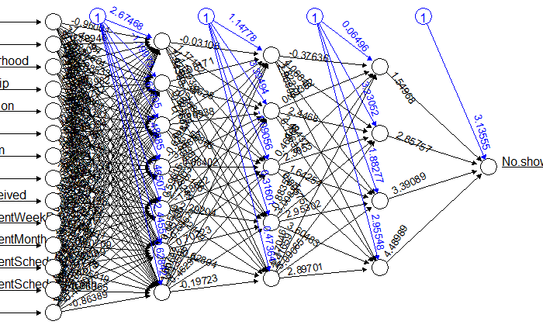
Support Vector Mode & Neural Network
SVM takes a very long time to train with our dataset
Produces roughly 80% accuracy rate with linear, radial or polynomial
The neural network has 2 hidden layers with 7, 5 neurons
Produces similar misclassification

Slide 14
Ensemble Modeling - Voting
KNN
Predict
Logistic Regression
Dataset
Predict
Vote
Answer
Random Forest
Predict

Slide 15
Ensemble Modeling - Stacking
Prediction
Prediction
Logistic Regression
GBM
KNN
Logistic Regression
Random Forest
KNN
Logistic Regression
Random Forest
Dataset
Dataset

Slide 16
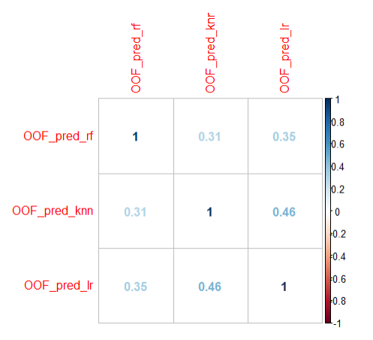
Ensemble Modeling - Stacking
Need to check the correlation between the models we’ve chosen
Using the probabilities we see that there is some correlation between the results

Slide 17
Results from Ensemble Modeling
STARTER | Voting | Stacked - GBM | Stacked - Logistic
Accuracy | 79.8% | 79.86% | 79.8%
Misclassification | 20.2% | 20.14% | 20.2%
Sensitivity | 79.84% | 79.84% | 80.63%
Specificity | 45.45% | 100% | 49.91%
Positive Predictive Value | 99.89% | 100% | 98.3%
Negative Predictive Value | 0.003% | 0.002% | 6.67%

Slide 18
Thank You!
Thank You!

